Slide 1
Design & Analysis
of Algorithms
Lecture # 11

Slide 2
In the Last Lecture
Counting Sort

Slide 3
Counting sort
The main shortcoming of counting sort it is useful for small integers i.e 1..k where k is small
If k is million or more the size of rank array would also be million
Radix sort provides a nice work around this limitation by sorting numbers one digit at a time

Slide 4
STEP 1
STEP 2
STEP 3
576
494
194
296
278
176
954
49[4]
19[4]
95[4]
57[6]
29[6]
17[6]
27[8]
9[5]4
5[7]6
1[7]6
2[7]8
4[9]4
1[9]4
2[9]6
[1]76
[1]94
[2]78
[2]96
[4]94
[5]76
[9]54
176
194
278
296
494
576
954

Slide 5
Radix Sort
Here is the algorithm that sorts A[1…n] where each number is d digit long
Radix_Sort(A,n,d)
for i← 1 to d
do stable sort with w.r.t. ith
order digit

Slide 6
Bucket Sort
Assumption: Input elements are uniformly distributed over [0,1]
n inputs dropped into n equal sized sub intervals or buckets

Slide 7
.78
0
/
.17
1
.12
.17
/
.39
2
.21
.23
.26
/
.26
3
.39
/
.72
4
/
.72
.94
5
/
.94
.21
6
.68
/
.12
7
.72
.78
/
.23
8
/
.68
9
.94
/

Slide 8
.12
.17
/
.21
.23
.26
/
.39
/
.68
/
.72
.78
/
.94
/

Slide 9
Question?
Good Sorting Algorithms are recursive…..
Is recursion (Divide and Conquer) solution of every problem?

Slide 10
Fibonacci Series
Observe the sequence
1,1,2,3,5,8,13,21,34,55 …….
Each number is sum of preceding two numbers

Slide 11
Fibonacci Sequence
The Fibonacci numbers F_{n} are defined recursively as follows
F₀= 0
F₁ = 1
F_{n} = F_{n-1} +F_{n-2}

Slide 12
Fibonacci Sequence (recursive definition )
Fib(n)
if(n<2)
return n
else
return Fib(n-1)+Fib(n-2)
T(n)=Θ(1.618^{n})

Slide 13
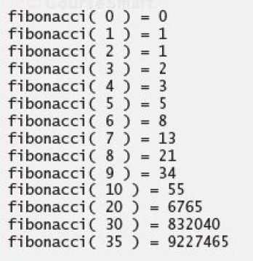

Slide 14
Four level Recursive calls for Fib(8)
Fib(8)
Fib(7)
Fib(6)
Fib(5)
Fib(5)
Fib(4)
Fib(6)
Fib(5)
Fib(4)
Fib(4)
Fib(3)
Fib(4)
Fib(3)
Fib(3)
Fib(2)
Fib(3)
Fib(2)
Fib(3)
Fib(2)
Fib(2)
Fib(1)
Fib(2)
Fib(1)
Fib(1)
Fib(0)
Fib(4)
Fib(3)
Fib(3)
Fib(2)
Fib(2)
Fib(1)

Slide 15
Fibonacci Sequence
A single recursive call to Fib(n) results one recursive call to Fib(n-1)
Two recursive calls to Fib(n-2)
Three recursive calls to Fib(n-3)
In general k calls to Fib(n-k)
For each call, we’re re-computing the same Fibonacci number from scratch

Slide 16
Fibonacci Sequence
We can avoid this unnecessary repetition by writing down the results of recursive calls and looking them up again if we need them later
This process is called memoization

Slide 17
Iterative Fibonacci Solution
Iter_fib(n)
F[0]← 0
F[1]← 1
for i← 2 to n
F[i] ← F[i-1]+F[i-2]
return F[n]

Slide 18
Fibonacci Series
This algorithm clearly takes only O(n) time to compute F_{n}
By contrast, the original recursive algorithm takes
Θ(1.618^{n})

